Slide 1
Bubble charts with d3
Creating a visualization of the nasdaq stock exchange top 100 companies using d3.

Slide 2
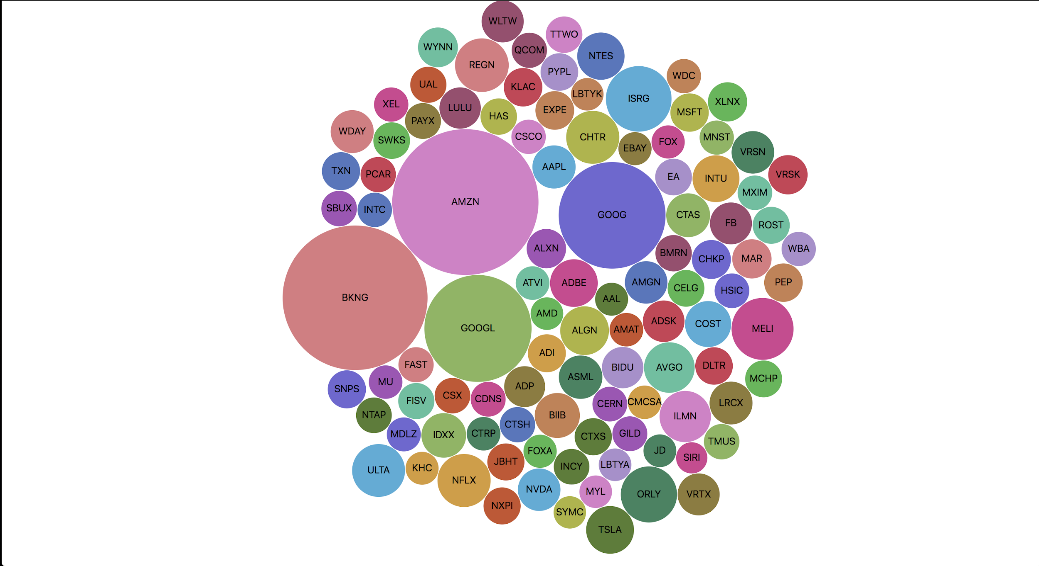
End result

Slide 3
Prerequisites
Backend
Flask (For deployment)
Pandas (For data processing)
Requests (For making a request to the nasdaq stock exchange server)
Virtualenv (For container isolation)
Frontend
Bower (Package management, old I know)
D3.js (Data visualization)
Jquery (D3 dependency and dom control)
Bootstrap (Styling)

Slide 4
App structure
app.py
.bowerrc
bower.json
stock_scraper.py
utils.py
Static
Bower_components (bower dependencies)
Main.js
Templates
index.html

Slide 5
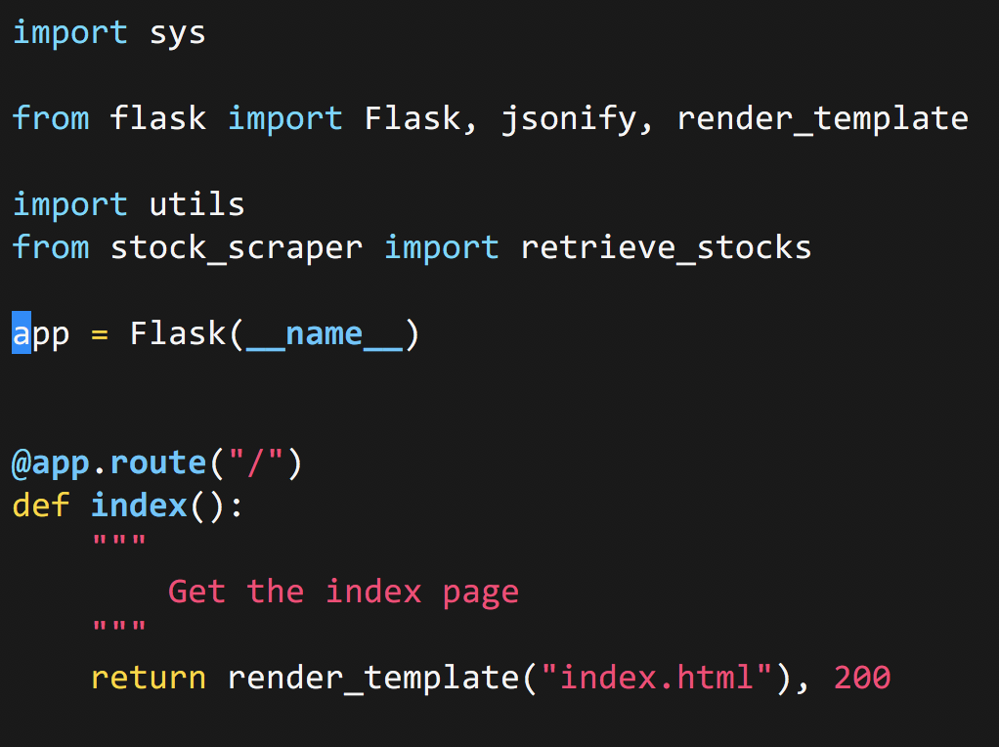
Getting started within our app.py
First things first is getting our imports out of the way. We then as for any flask app instantiate the flask object, and then create our index route.

Slide 6
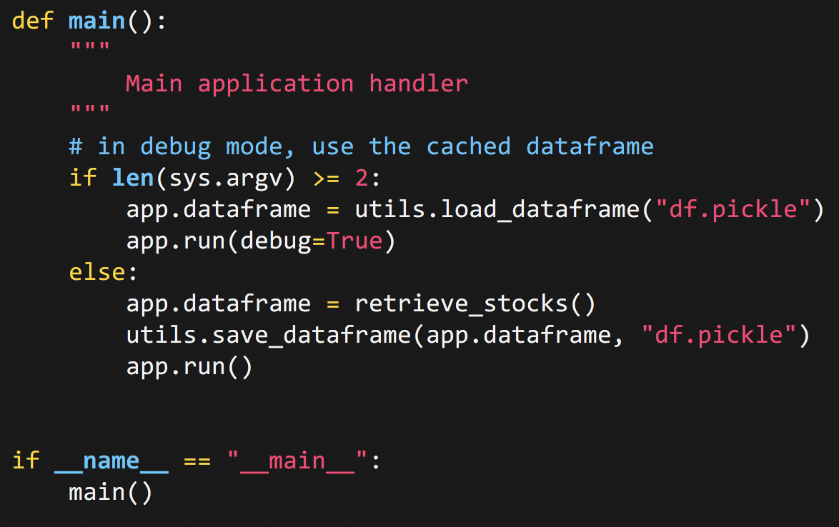
app.py
At the bottom of the file, we create a main function which will grab our dataframe and create our app.
retrieve_stocks() is a function from stock_scraper that we will utilize to grab the stocks.
utils.load_dataframe() and utils.save_dataframe() are custom functions we’ll create next for loading and saving our dataframe.

Slide 7
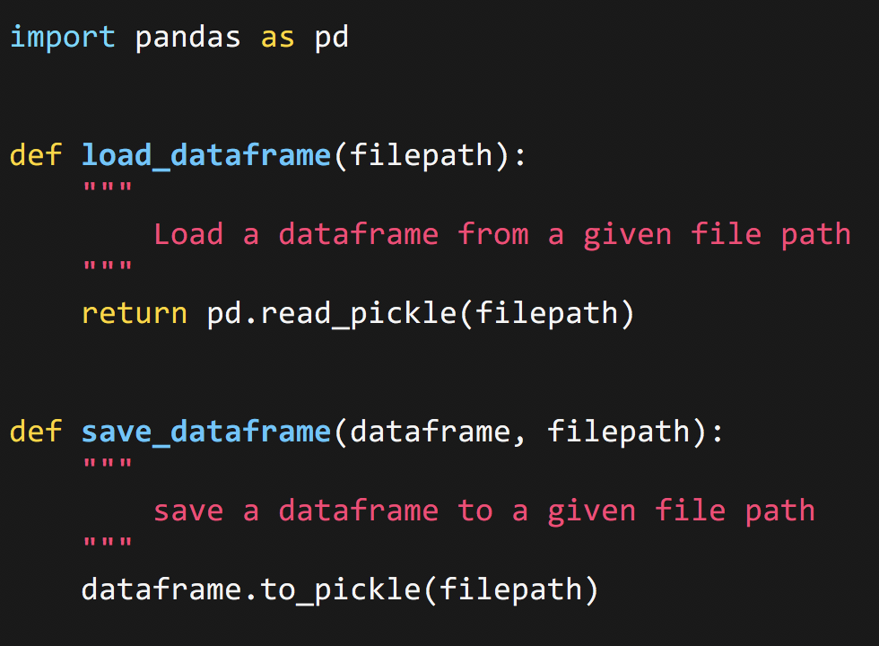
utils.py
This file simply handles reading and writing our dataframe using pickle, a binary format proprietary to python and python objects.

Slide 8
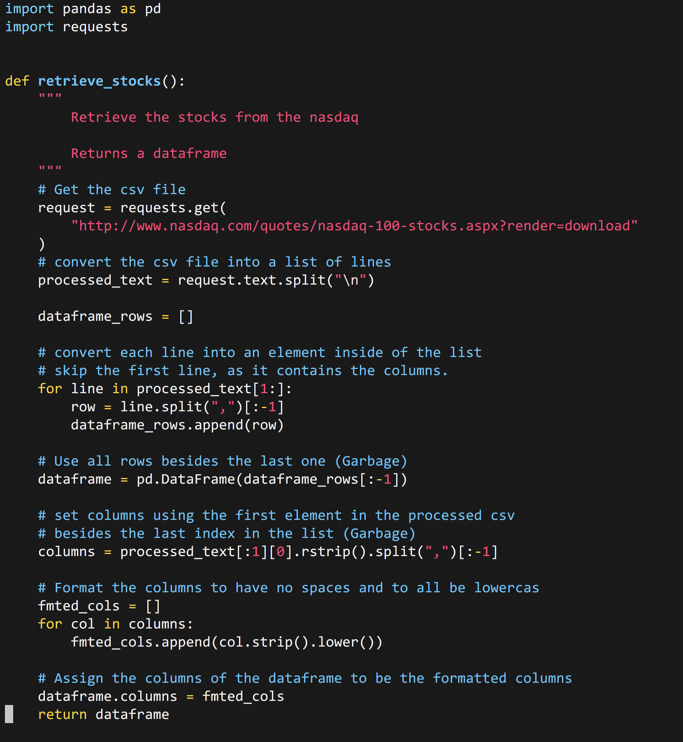
Retrieving stocks
(stock_scraper.py)
With any function that is a lot to digest, we need to break it down into smaller steps. What’s basically going on here is:
Making a request for the csv file
Parsing the csv file to work with pandas
Formatting the columns
Returning the dataframe

Slide 9
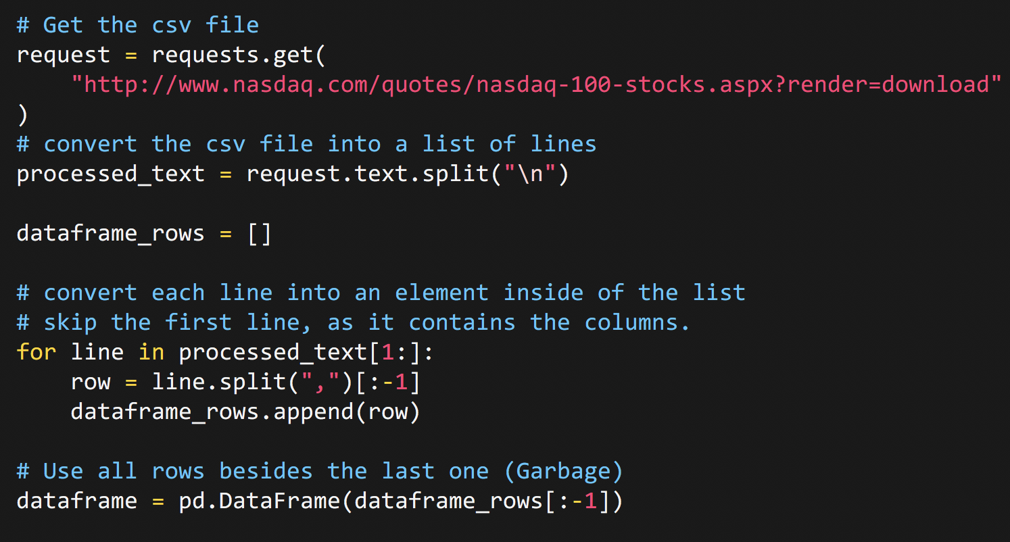
Making the request and processing data
Using requests, we can can make a request to nasdaq's domain to grab the csv file.
Since the csv isn’t saved, we’re going to need to do some work to get it there.

Slide 10
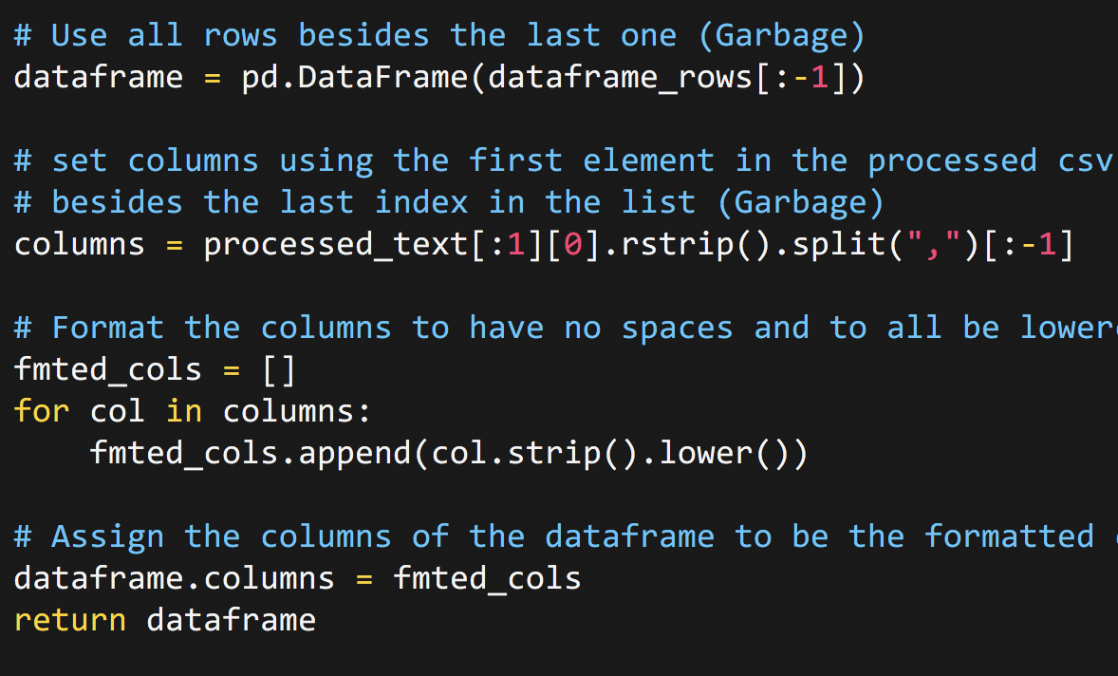
Grabbing the columns and formatting them
In this last bit of the code, we parse through the columns that we’d like to use within our dataframe.
After we’re done, we return the dataframe!

Slide 11
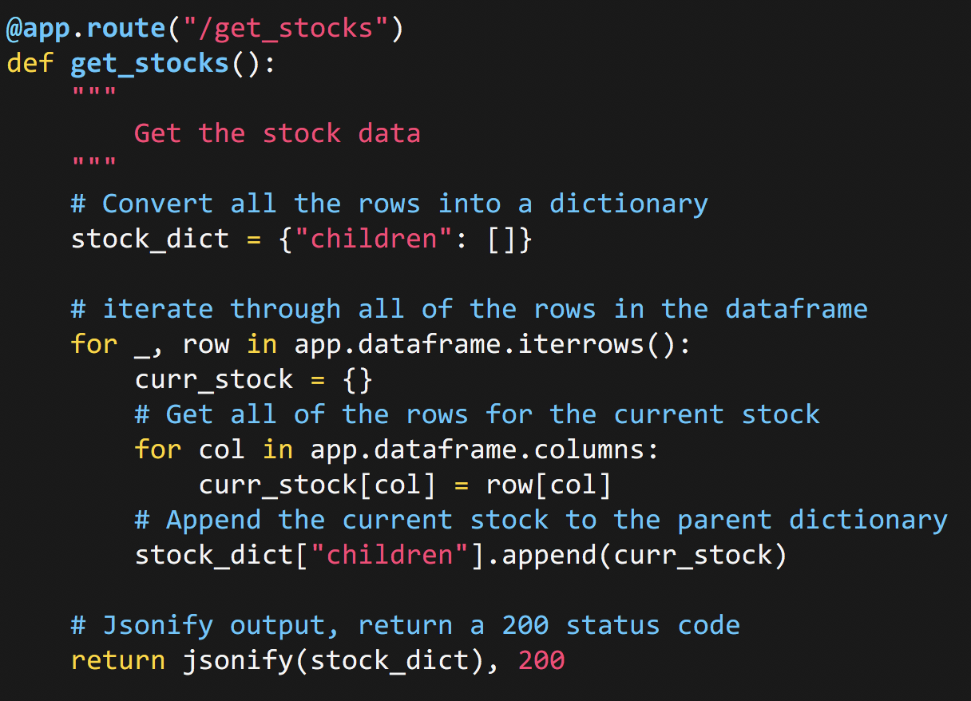
Back to our app.py
Now since we’ve constructed our supporting functions, we’re going to create the route that will be sending the data to our frontend. We create a dictionary with one predefined k,v pair called children which maps to a list.
We then iterate over all the rows, populating them in dicts to use for our custom json response.

Slide 12
Building out the frontend

Slide 13
Installing bower
Assuming you have bower installed and my .bowerrc and bower.json file, you can do
bower install

Slide 14
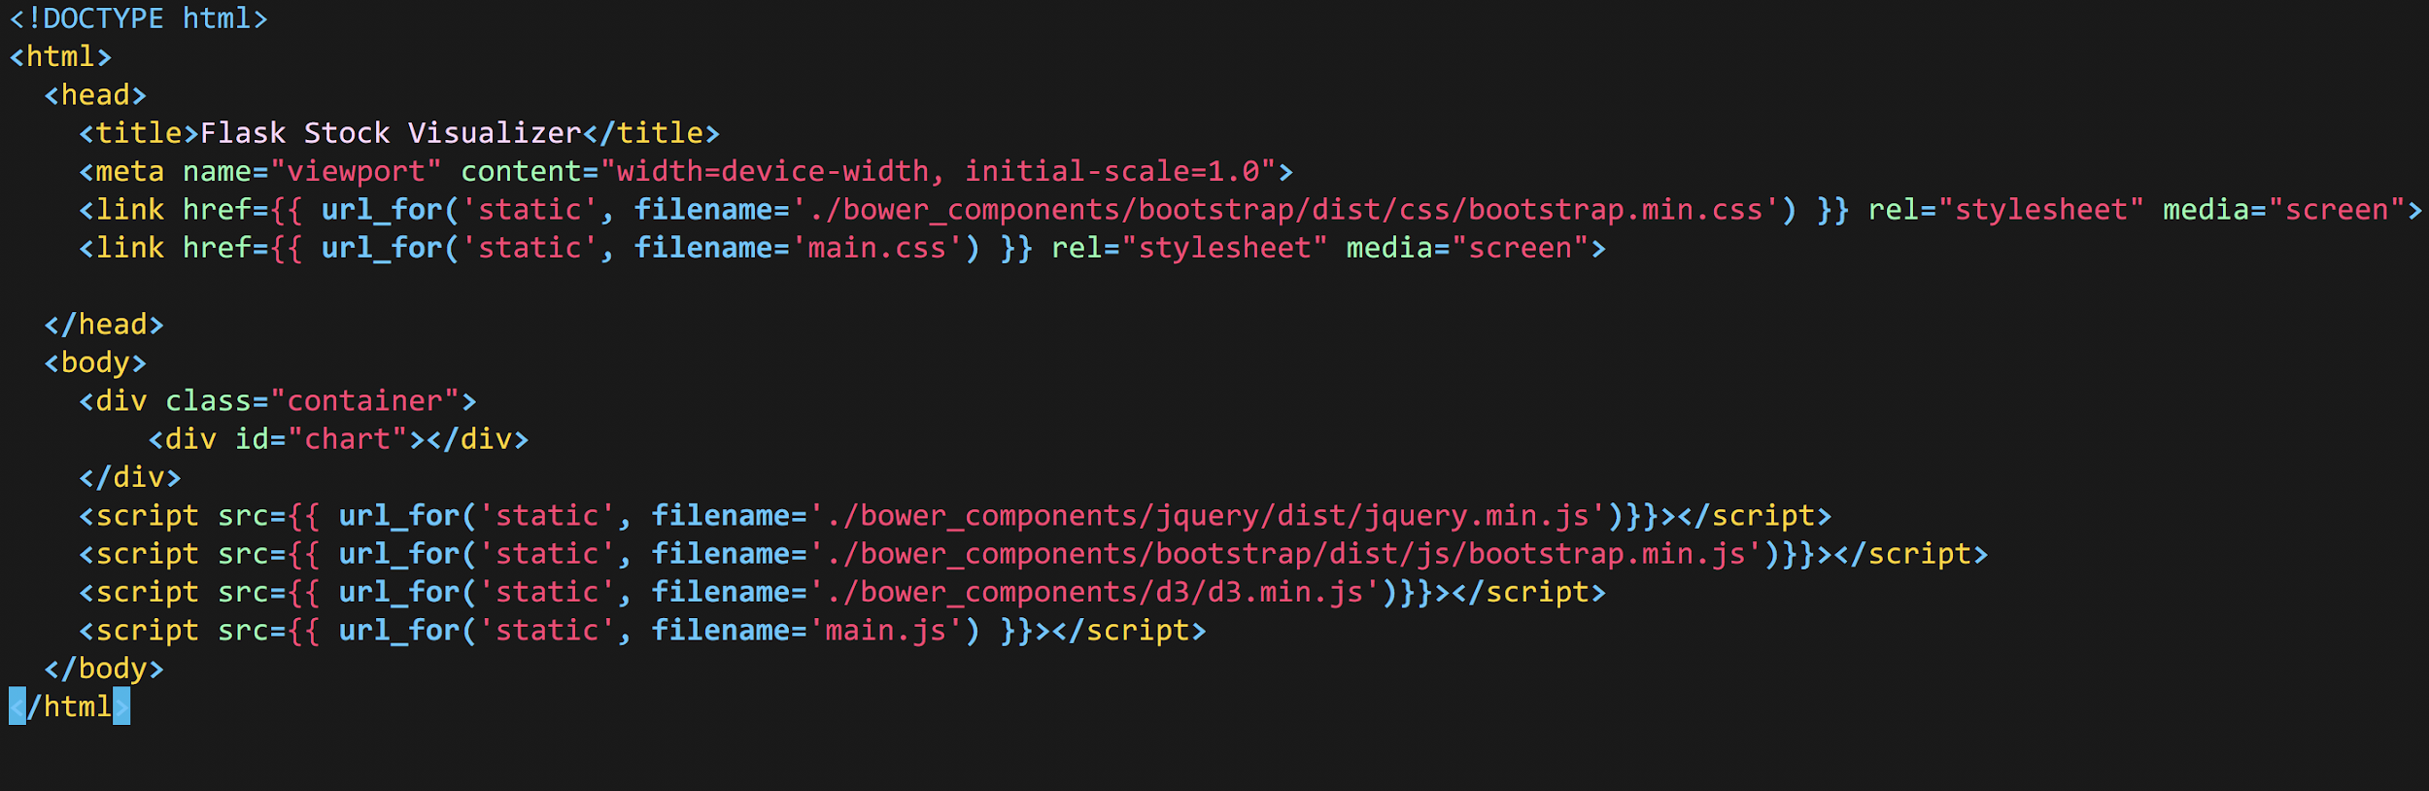
Setting up our index.html

Slide 15
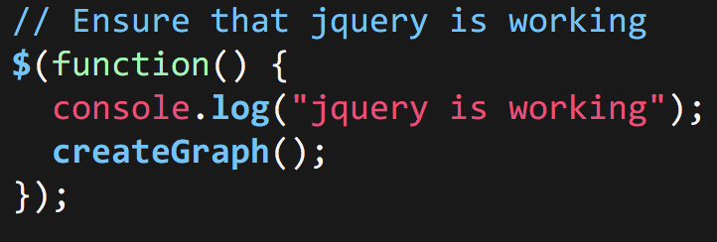
The first step in our index.js

Slide 16
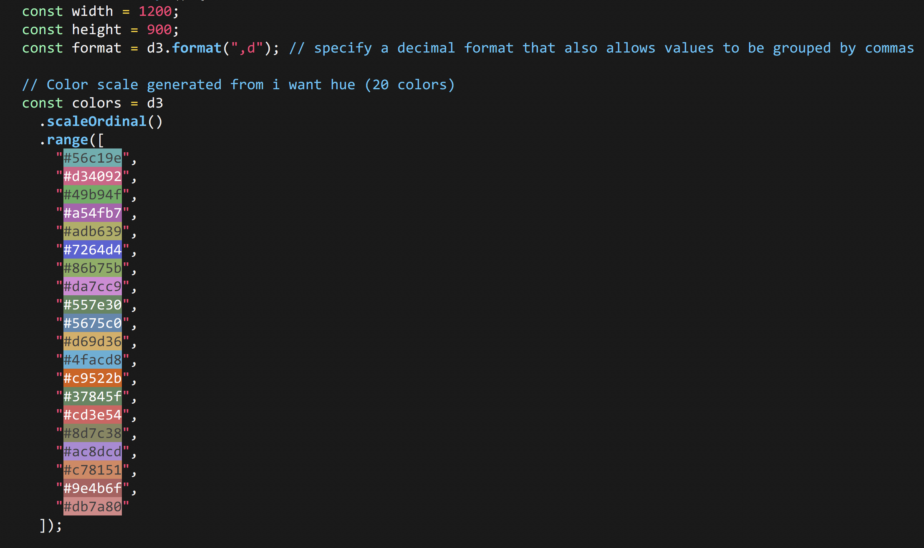
Inside createGraph()
Inside of our createGraph() function, we start working with d3.
We specify format which will allow d3 to automatically format decimals with commas automatically
We also specify colors, which is the colors in which the bubbles will use to be filled

Slide 17
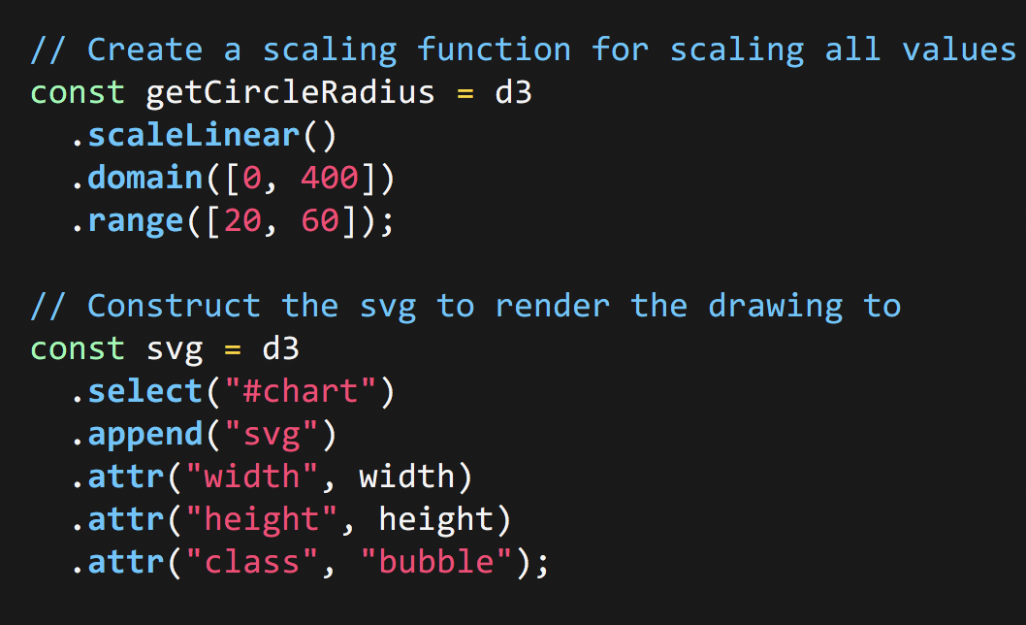
Generating the circle radius and svg
While our getCircle radius function has no use now, it will be used for calculating the radius of our bubbles. We specify a domain, between 0 and 400, which then maps to a range of 20 to 60.
Our svg on the other hand will be what we’re rendering to, utilizing the width and height we specified earlier.

Slide 18
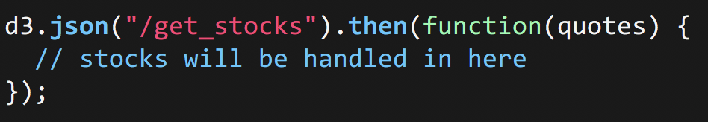
d3.json

Slide 19
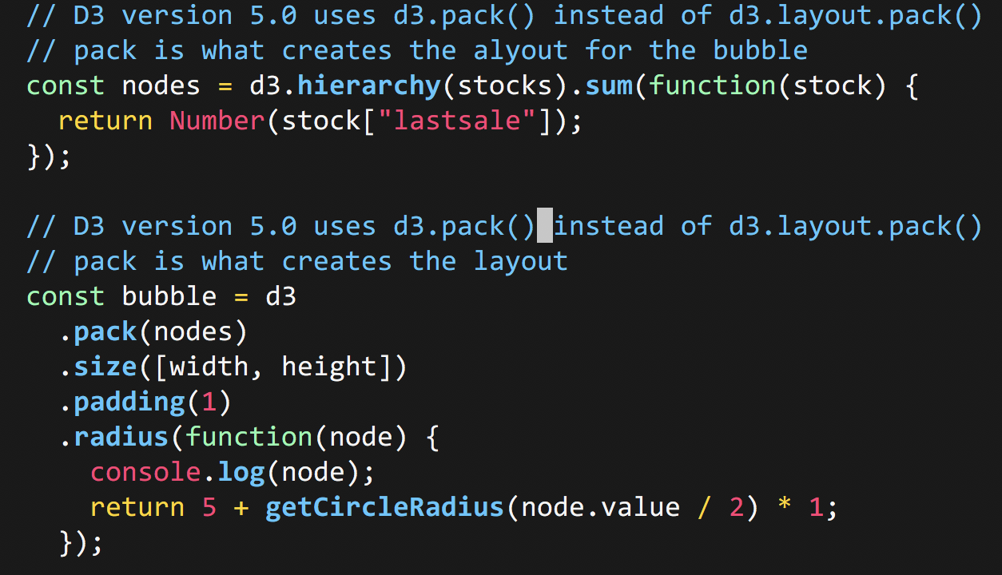
Creating the layout and bubble chart

Slide 20
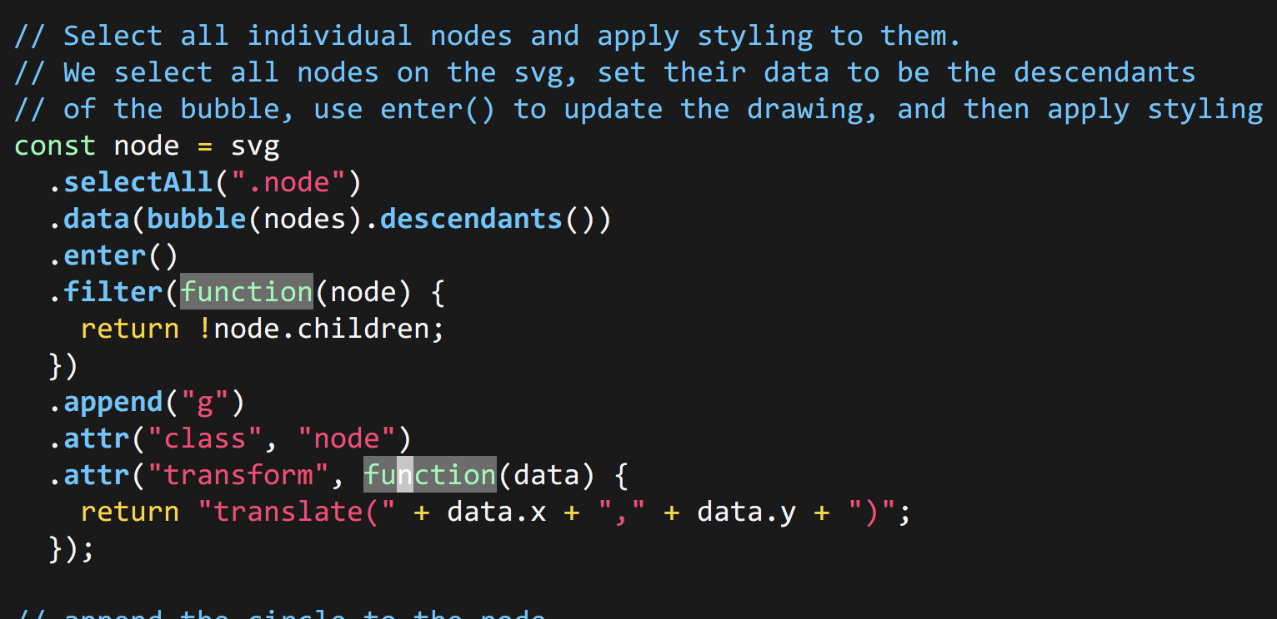
Selecting the each node and fill

Slide 21
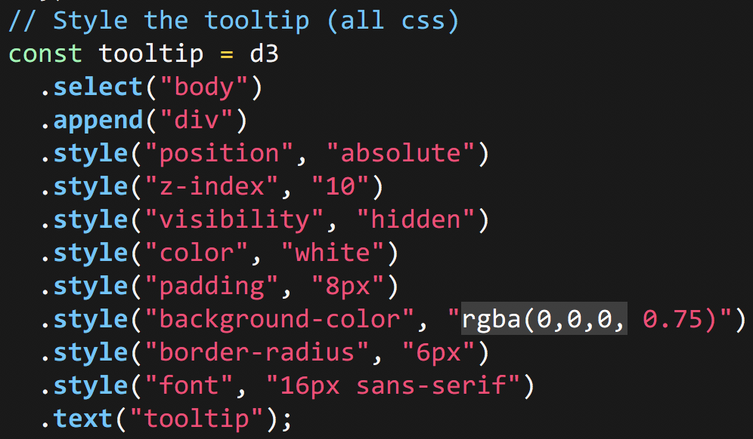
Creating the tooltip for each bubble

Slide 22
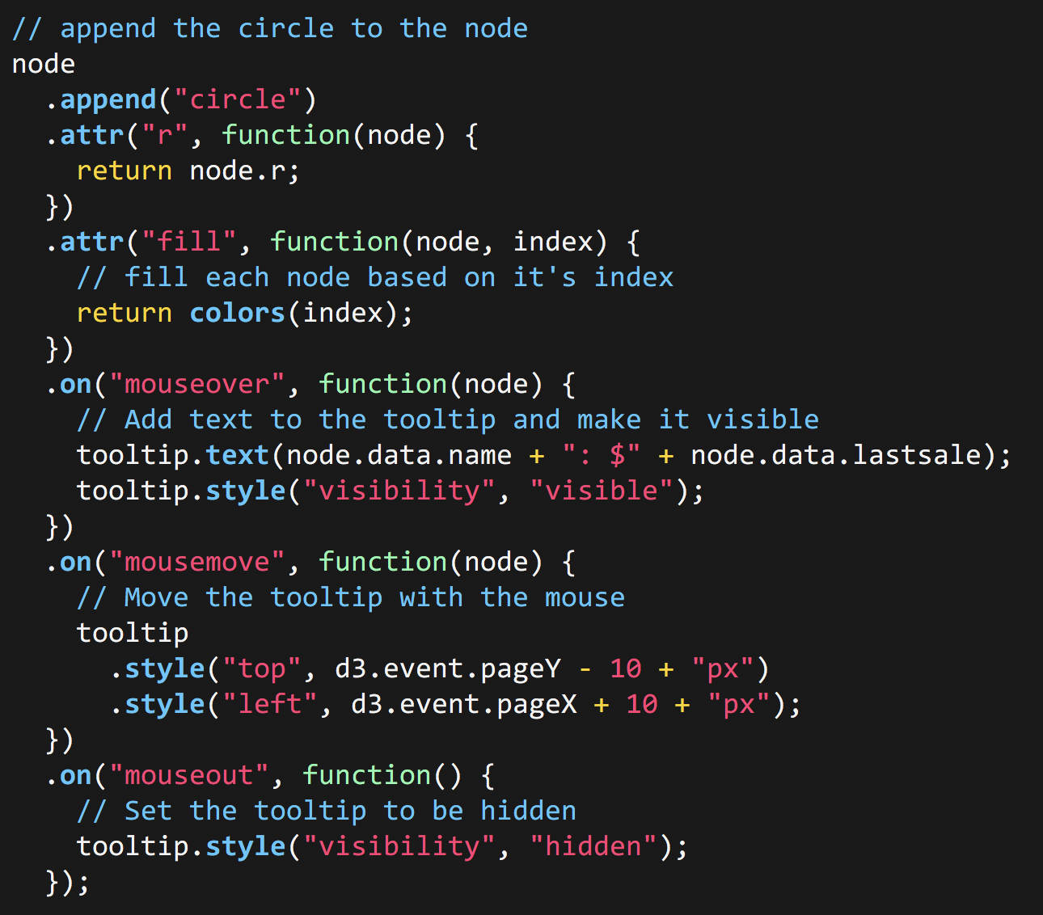
Drawing the node and adding functionality to it.
We append circle, to the node. This creates an SVG circle item, which we can then give a radius and color.
On simply allows us to add classic javascript event listeners to our circles, giving us functionality for the tooltip

Slide 23
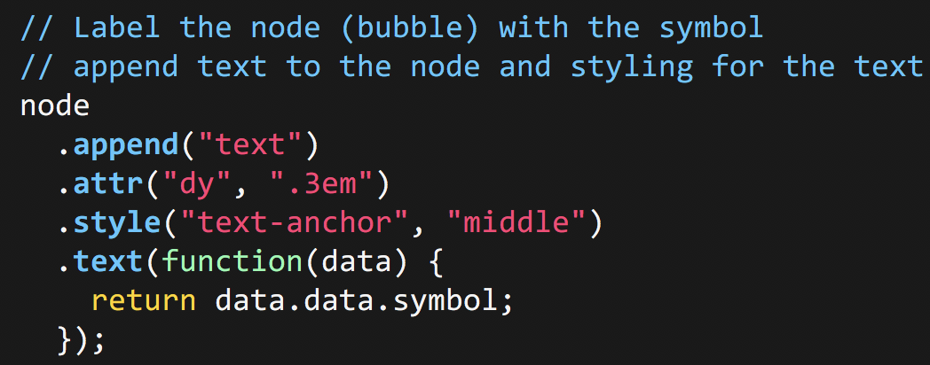
Finally

Slide 24
End result

Slide 25
Closing thoughts
Adding more features
More information on tooltip
Creating an interactive interface
Utilizing some other visualizations that d3 has to offer.
Formalizing this as a tutorial
https://github.com/C3NZ/nasdaq-viz

